Slide 1
Word Lesson 7 Working with Documents
Microsoft Office 2010 Introductory
Pasewark & Pasewark

Slide 2
Objectives
Insert page breaks, headers, footers, and page numbers.
Understand content controls.
Modify document properties.
Insert predesigned cover pages.
2
2

Slide 3
Objectives (continued)
Create a section with formatting that differs from other sections.
Use the Research tool.
Insert, modify, and format tables.
Sort text.
3
3

Slide 4
Vocabulary
cell
content control
footer
gridline
header
orphan
page break
property
section
sort
table
widow
4
4

Slide 5
Inserting Page Breaks
The place where one page ends and another begins is a page break. Word automatically inserts page breaks or you can insert one manually.
Avoid creating widows and orphans.
A widow is when the first line of a paragraph appears at the bottom of a page; an orphan is when the last line of a paragraph appears at the top of a page.
5
5

Slide 6
Understanding Content Controls
Many predesigned elements contain content controls, which are special placeholders designed to contain a specific type of text.
For most controls, you simply start typing.
For some controls, an arrow appears when you click the control, and you click the arrow to choose an item from a list or a date from a calendar.
6
6

Slide 7
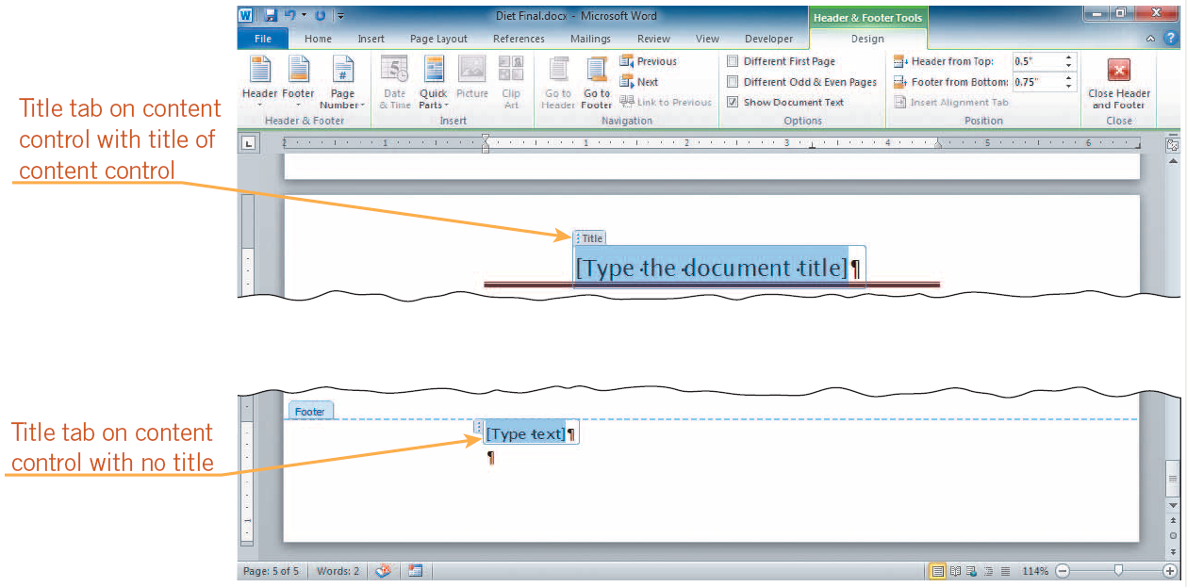
Understanding Content Controls (continued)
Content controls

Slide 8
Inserting Headers, Footers, and Page Numbers
Headers (top of page) and footers (bottom of page) allow you to include the same information, on each page of a document.
When the header or footer area is active, the Header & Footer Tools Design tab appears on the Ribbon.
The Different First Page option allows you to remove the header and footer from the first page of the document.
8
8

Slide 9
Inserting Headers, Footers, and Page Numbers (continued)
Page numbers are included in some of the header and footer styles.
Even if you choose a header or footer style that does not include page numbers, you can still insert a page number.
You can also insert the page number in an existing header or footer.
9
9

Slide 10
Modifying Document Properties
When you save a file, identifying information about the file is saved along with it, such as the author’s name. This information is known as the file properties. To view properties, click the File tab, and then click Info.
Content controls can be linked to document properties so that they pick up and display the information stored as a document property.
10
10

Slide 11
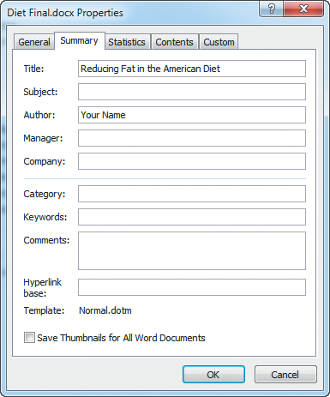
Modifying Document Properties (continued)
Summary tab in Diet Final.docx Properties dialog box

Slide 12
Inserting a Cover Page
You can quickly create a cover page for your document by inserting one of the many predesigned cover pages available with Word.
Cover pages contain content controls.
12
12

Slide 13
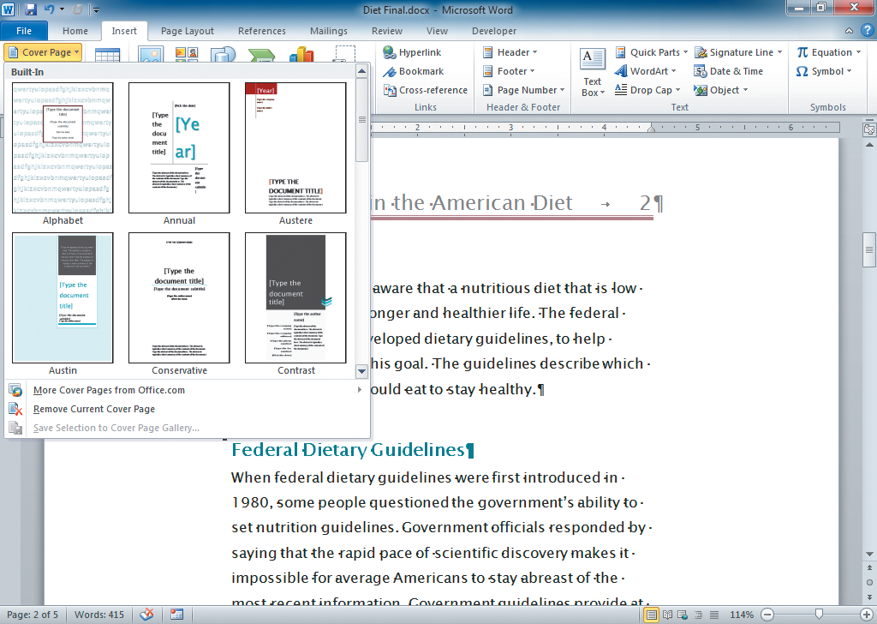
Inserting a Cover Page (continued)
Cover page gallery

Slide 14
Creating New Sections
You can divide a document into two or more sections. A section is a part of a document where you can create a different layout from the rest of the document.
You can also have different headers and footers, page numbers, margins, orientation, and other formatting features in different sections.
14
14

Slide 15
Using the Research Tool
Word provides online access to a dictionary, thesaurus, and other resources to help you research information.
You need an Internet connection for all research resources except the dictionary, thesaurus, and some features of the translation tool.
15
15

Slide 16
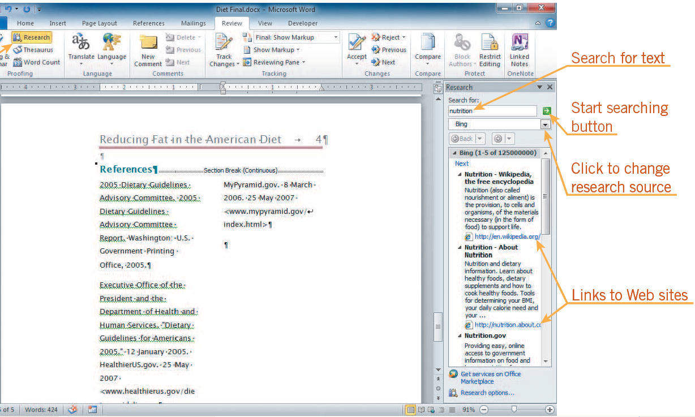
Using the Research Tool (continued)
Research task pane open with results from Bing search engine

Slide 17
Creating Tables
A table is an arrangement of text or numbers in rows and columns, similar to a spreadsheet. Tables are useful for organizing information. The intersection of a row and column is called a cell.
To enter text in a table, click in a cell, and then type. To move to the next cell to the right, press Tab or click in the cell.
17
17

Slide 18
Creating Tables (continued)
You can modify the structure of a table by using commands on the Table Tools Layout tab on the Ribbon, including:
Inserting or deleting a row or column
Changing the width of columns
Changing the height of rows
Splitting and merging cells

Slide 19
Creating Tables (continued)
The easiest way to format a table is to use one of the many predesigned formats on the Table Tools Design tab. Options include:
Adding shading to every other row or every other column
Manually formatting text
Changing the color of table lines and cells
Changing the alignment of text in a cell
Adding color to borders
19
19

Slide 20
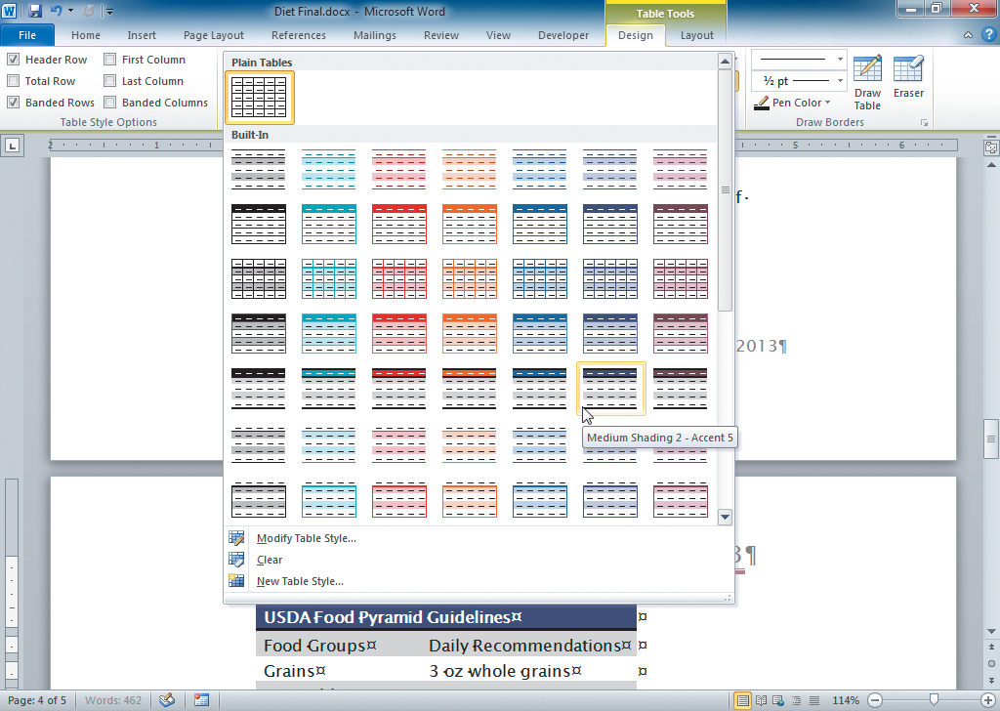
Creating Tables (continued)
Live preview of a table style

Slide 21
Converting Text into Tables
You can convert text you have already typed into a table.
Select the text, and then on the Insert tab on the Ribbon, click the Table button in the Tables group, and click Convert Text to Table on the menu.
21
21

Slide 22
Sorting Text
Sorting arranges a list of words in ascending order (a to z) or in descending order (z to a).
Sorting can also arrange a list of numbers.
To sort text in a table, click anywhere in the table, click the Table Tools Layout tab, and then in the Data group, click the Sort button.
22
22

Slide 23
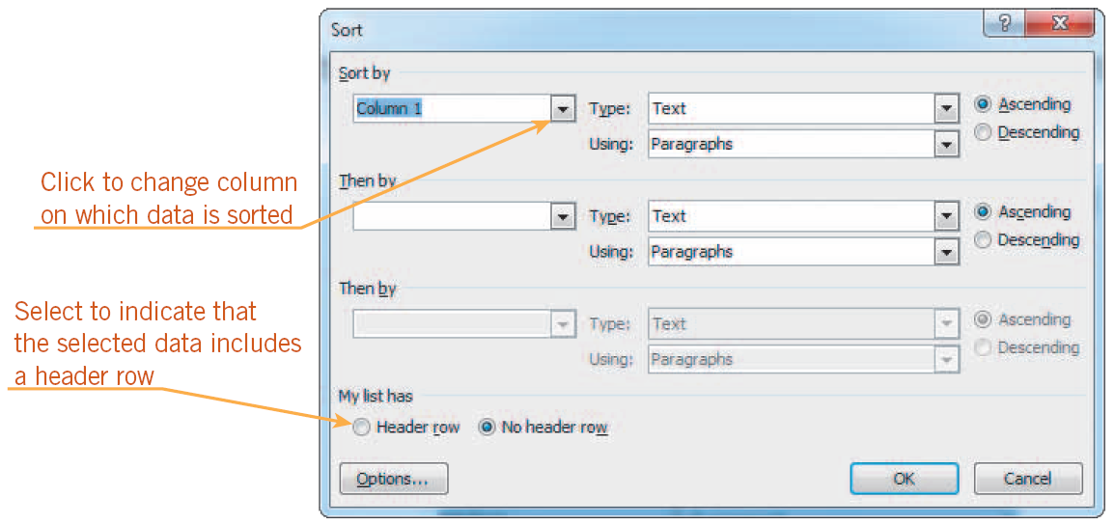
Sorting Text (continued)
Sort dialog box

Slide 24
Summary
In this lesson, you learned:
Word automatically inserts page breaks where they are necessary. You also can insert page breaks manually.
Content controls are special placeholders designed to contain a specific type of text. When you insert text, some content controls remain in the document and some are deleted.
You can insert page numbers in the header or footer area. The page number style can replace a header or footer, or you can use the Current Position command to insert a page number at the location of the insertion point.
24
24

Slide 25
Summary (continued)
You can modify file properties in Backstage view. Some types of content controls are linked to document properties.
You can insert a predesigned cover page with content controls by clicking the Cover Page button in the Pages group on the Insert tab.
To create different page layouts within one document, divide the document into sections.
The Research tool allows you to access the Internet to explore different sources for information.
25
25

Slide 26
Summary (continued)
Tables show data in columns and rows. You can modify tables by adding and removing rows and columns and merging and splitting cells. You can format a table with styles as well as use manual formatting. You can convert text into a table with the Convert Text to Table command.
You can sort text in a document alphabetically or numerically in ascending or descending order.
26
26

